Slide 1
The Art of the Possible
Dr John Unsworth QN
Chair, The Queen’s Nursing Institute

Slide 2
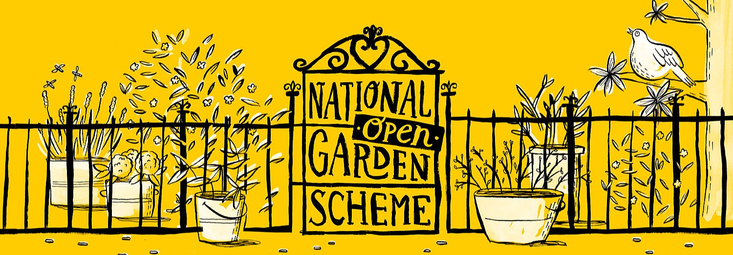

Slide 3
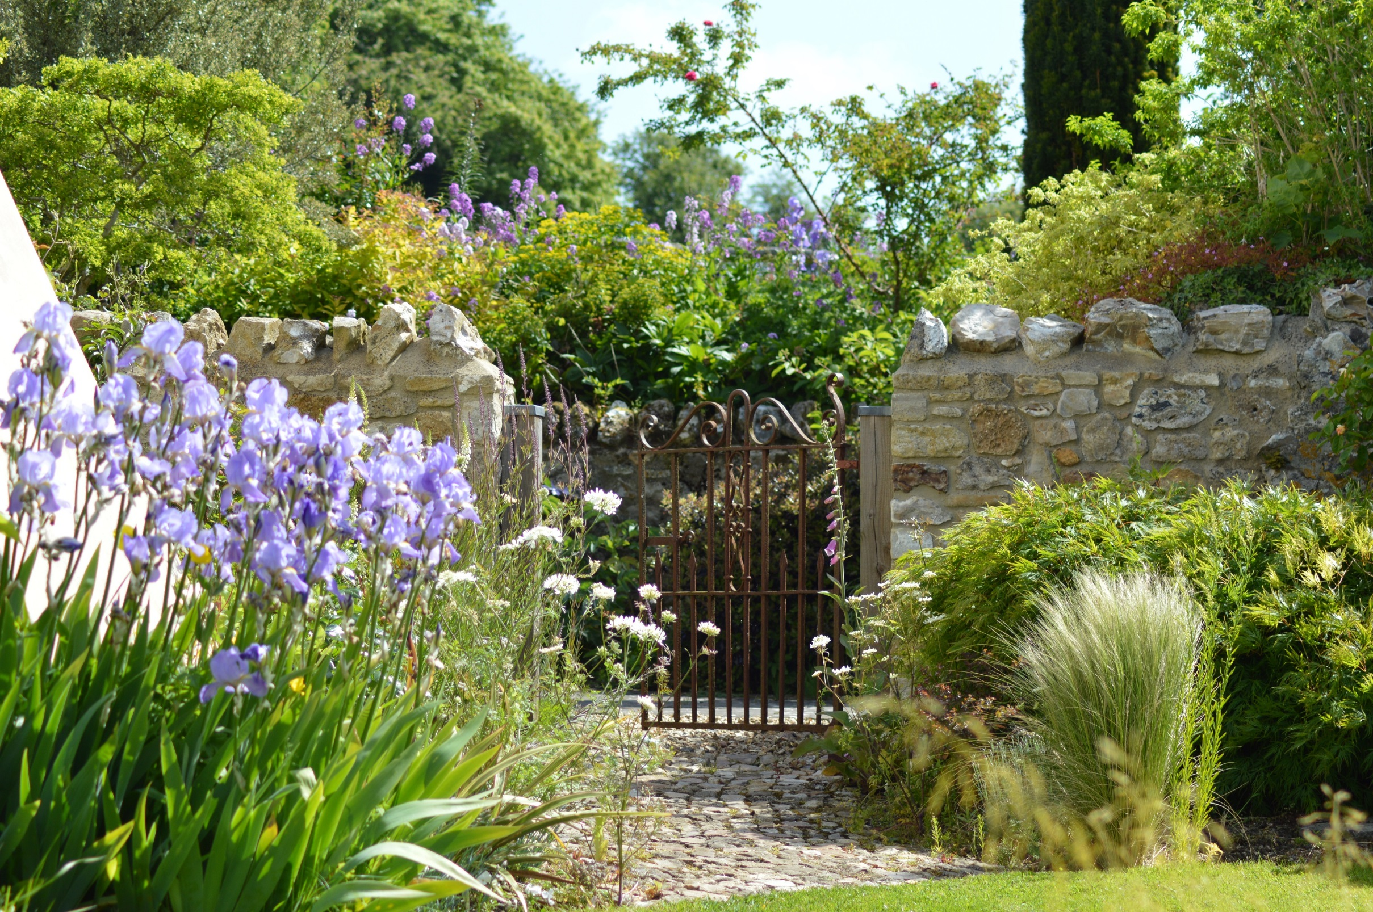

Slide 7
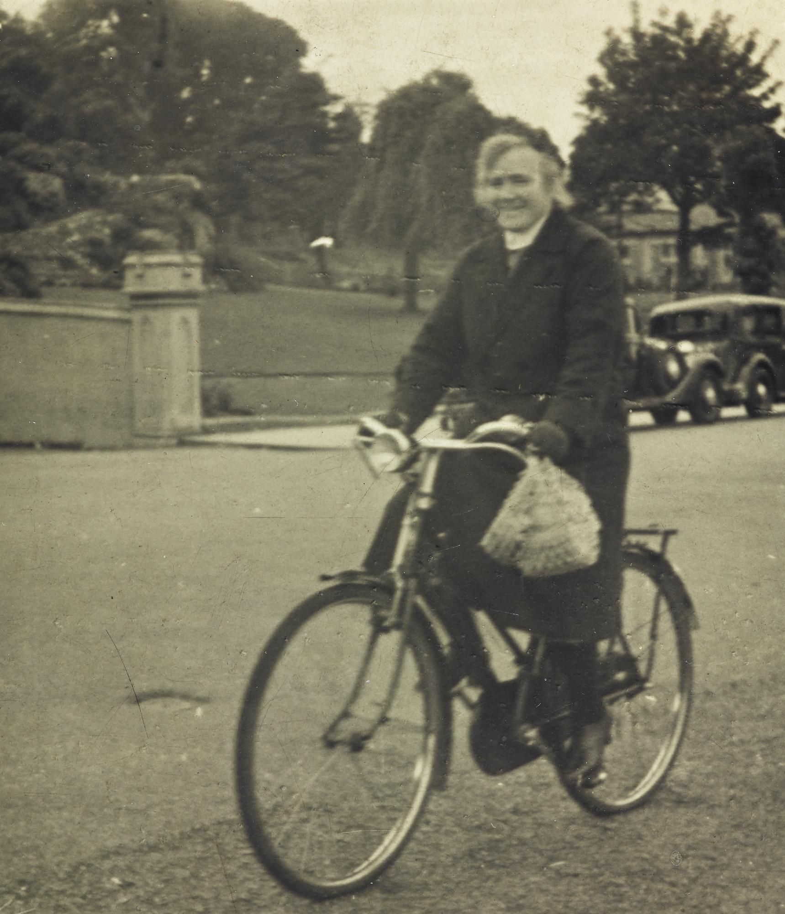

Slide 8
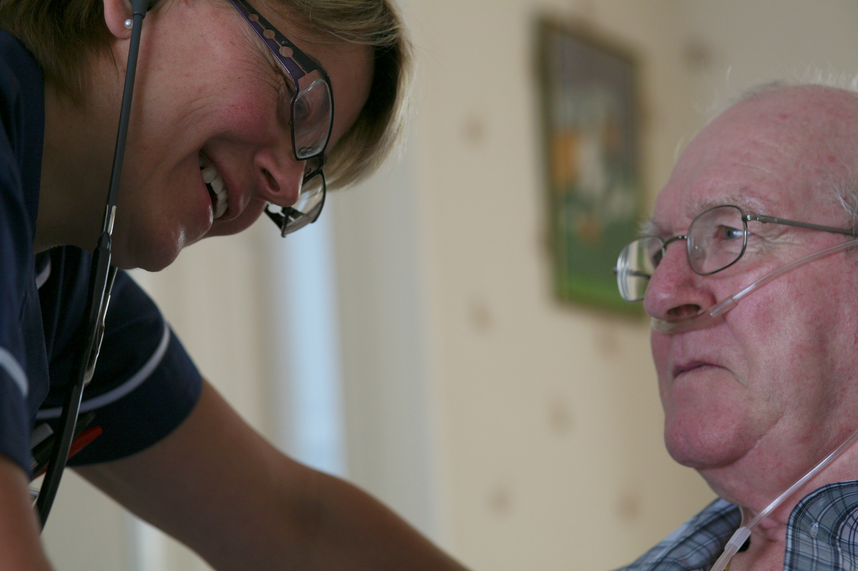

Slide 9
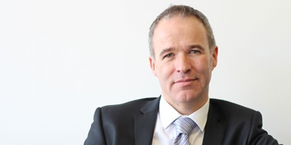
“.. my staff perform little miracles every day”

Slide 10
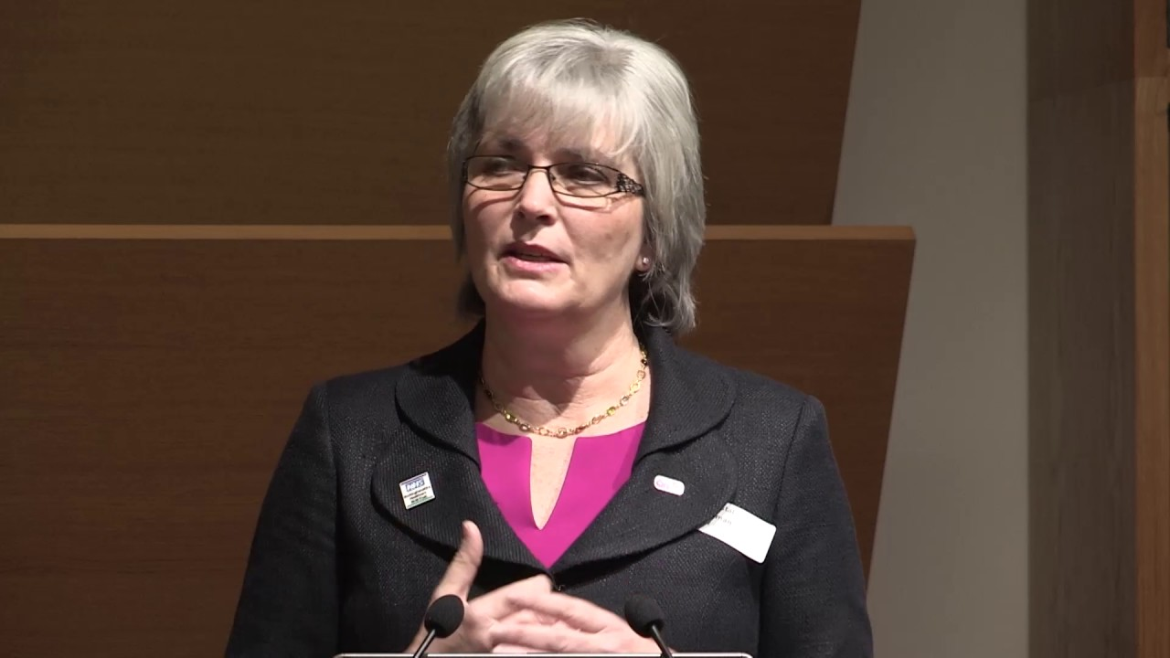

Slide 12
#extraordinaryQNs
@TheQNI
@johnunsworth10

