Slide 1
Power of Variation & Value of Nurses in the Community
Michelle Mello Clinical Lead, Personalised Care Group
Professor Muir Gray
Clinical Advisor, NHS RightCare

Slide 2
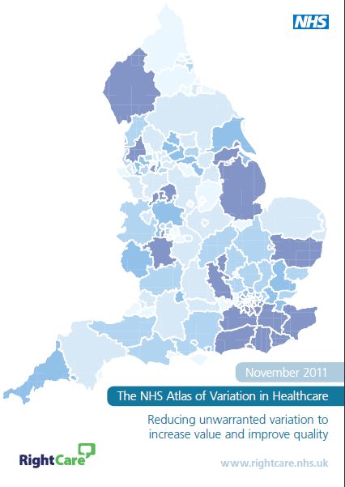
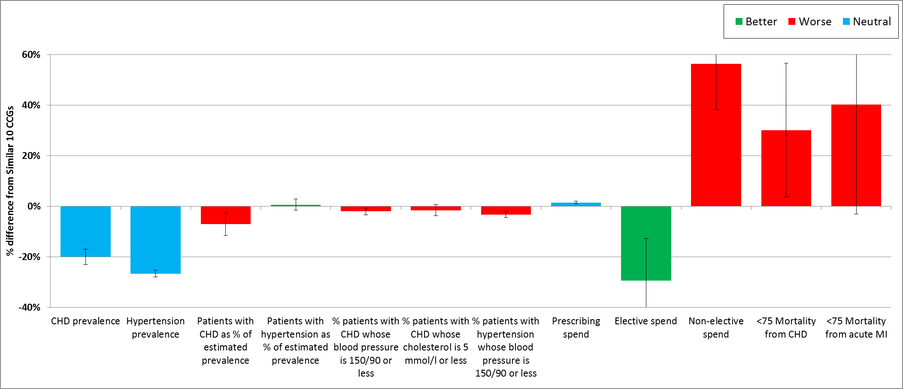
Awareness is the
1st step to population
healthcare
improvement
If the existence of clinical and financial variation is unknown, the debate about whether it is unwarranted cannot take place

Slide 3
Why is variation important?
Some variation is good
Optimal vs standard pathways
Links with overuse & underuse which can lead to low value care (outcomes, experience & cost)
As nurses we can directly influence

Slide 4
What is unwarranted variation?
Where the variation can’t be explained and may have harmful consequences
Help us understand the differences in:
how services are provided
the outcomes being achieved
what they cost

Slide 5
NHS RightCare’s essentials of population healthcare

Slide 6
Betty’s story

Slide 7
Statistics
The annual cost of managing wounds in the NHS and associated comorbidities is £5.3 billion
1.5% of the UK population are estimated to have a leg ulcer (of patients recorded in an NHS setting with a wound within one year)
There is evidence of unwarranted variation in the assessment and treatment of leg ulcers (see the main paper and the research studies referenced.)
Wound care is 39% of a district nursing service workload (NHS Benchmarking 2016 annual audit)
Notes:
(rate of falls & 10 days)

Slide 8
Betty and the sub-optimal pathway
Prevention Focus
Health and wellbeing
Care and quality
Funding and efficiency
Delayed healing
Increased side effects and complications
Delayed assessment
Greater understanding of need is required
Poor impact on the patient and staff
Expensive dressings and treatment
Hospital costs
Poorer outcomes
Poorer experience
Poorer use of resources

Slide 9
Betty and the optimal pathway
Prevention Focus
Health and wellbeing
Care and quality
Funding and efficiency
Faster healing
Reduced side effects
Timely
Timely assessment
Greater understanding of need
Reduced dressing costs
Better organisation of care
Better outcomes
Better experience
Better use of resources

Slide 10
Financial information
Analysis by provider | Sub-optimal | Optimal
Acute | £1,703 | £0
Ambulance service | £466 | £0
Community teams | £2,167 | £12
Primary care | £1,334 | £346
Pharmacist | £3 | £3
Leg ulcer pathway | £0 | £144
Grand total | £5,673 | £505
In the suboptimal scenario:
- Dressings represent £1,353 (24%) of the total costs versus £88 in the optimal pathway.
- Clinical time represents £2,139 (38%) of the total costs versus £195 in the optimal pathway.

Slide 11
Implications for nurses
Take a closer look at what we do – know & share the impact of what we do
Uncover activities that we need to change, add or take away – use evidence & best practice
Challenge established practice because we understand that service can be delivered in a better way – drive optimal pathway development
Use Leading Change, Adding Value as an enabler -use levers & incentives to help get started

Slide 12
What matters to you?

Slide 13
Further information
For more information about Betty’s journey, NHS RightCare or long term conditions you can:
Email
rightcare@nhs.net
england.longtermconditions@nhs.net
Visit
https://www.england.nhs.uk/rightcare/
Tweet
@NHSRightCare

